Slide 1
Economic Outlook of Canada
Principles of Macroeconomics, Biwei Chen, Semester 2
Caleb Bailey, Student, caleb.bailey25@houghton.edu, 3/18/21

Slide 2
Table of Contents
National Income and Growth.....3-4
Labor Market Conditions.....5
Price Level and Inflation.....6
Money and Interest Rates.....7-8
Financial Markets.....9
Reference Page.....10

Slide 3
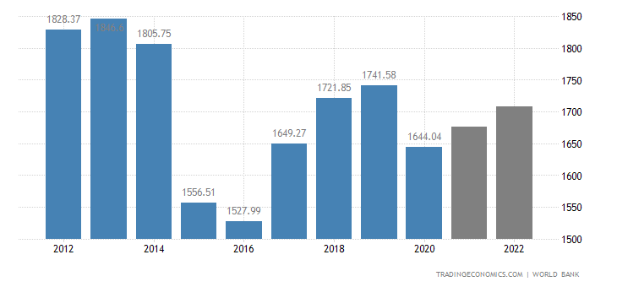
National Income and Growth
Canada saw an economic growth of 6.7% in 2021, the highest it has been since the Covid-19 outbreak
A decrease is projected for 2022, coming down t0 4.0%
Canada’s National Income for the year 2021 was $1670.00 USD Billion – www.tradingeconomics.com
A projected $1740.00 is set for 2022

Slide 4
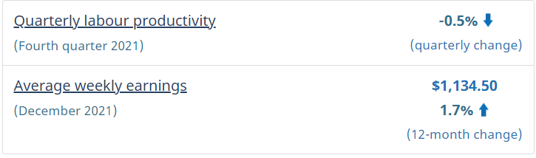
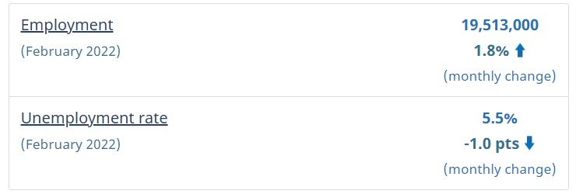
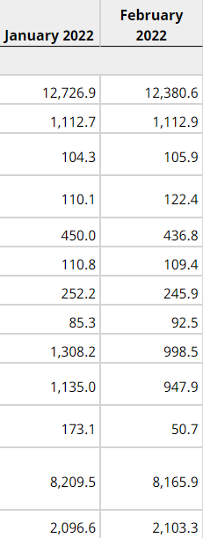
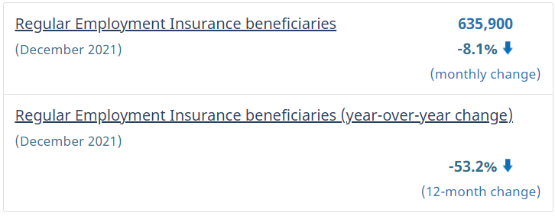
Labor Market Conditions
Unemployment numbers in Canada, everyone over 15 years of age
Screenshots from https://www150.statcan.gc.ca

Slide 5
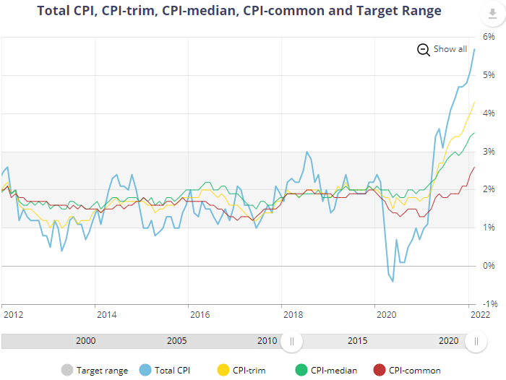
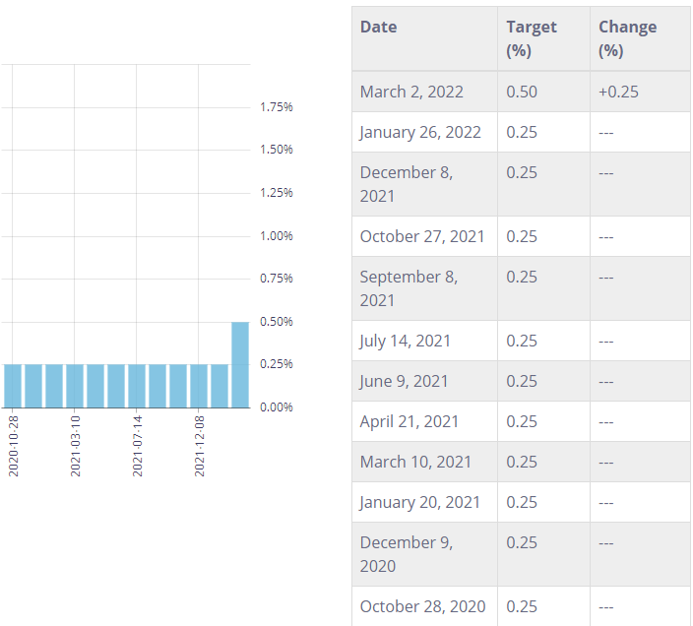
Price Level and Level Inflation
Canada’s inflation rate increased to 4.8%
This is the highest it has been since 1991
Due to higher prices of food, passenger vehicles and housing
https://www.business-standard.com
Policy Interest Rate

Slide 6
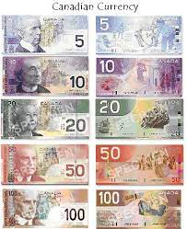
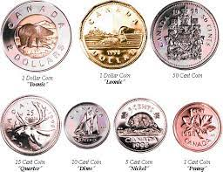
Money and Interest Rates
Current Bank Prime Rate = 2.7%
This is up from previous 2.45%
https://bankofcanada.ca
Canadian Currency, 1 Canadian Dollar = 0.79 US Dollar
Current Interest Rate is 0.5%, up from the previous .25%
Rate is set to land at 1.25% at the end of 2022

Slide 7
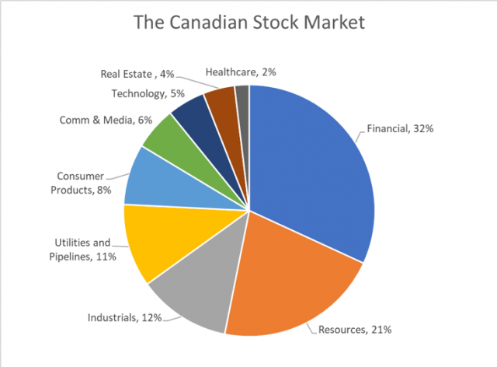
Financial Markets
Consist of:
Markets for money
Bonds
Equities
Derivatives
Foreign Exchange
9th largest economy in the world
Sitting high up in world financial markets
https://keystocks.com

Slide 8
Reference Page
https://economics.td.com/ca-quarterly-economic-forecast#:~:text=Compared%20to%20our%20September%20forecast,shutdowns%20and%20ongoing%20input%20shortages.
https://tradingeconomics.com
https://bankofcanada.ca
https://craigmarlatt.com
https://quora.com
https://economics.td.com/ca-quarterly-economic-forecast#:~:text=Compared%20to%20our%20September%20forecast,shutdowns%20and%20ongoing%20input%20shortages.
https://www.150statcan.gc.ca
https://www.business-standard.com
https://Investopedia.com
https://www.keystocks.com

